Slide 1

Multi Agent Navigation in Unconstrained Environments using a Centralized Attention based Graphical Neural Network Controller
Yining Ma*^{1,2}, Qadeer Khan*^{1,2}, Daniel Cremers^{1,2,3}
*indicates equal contribution
¹Technical University of Munich (TUM), School of CIT
²Munich Center for Machine Learning (MCML)
³University of Oxford
IEEE International Conference on Intelligent Transportation Systems ITSC 2023

Slide 2
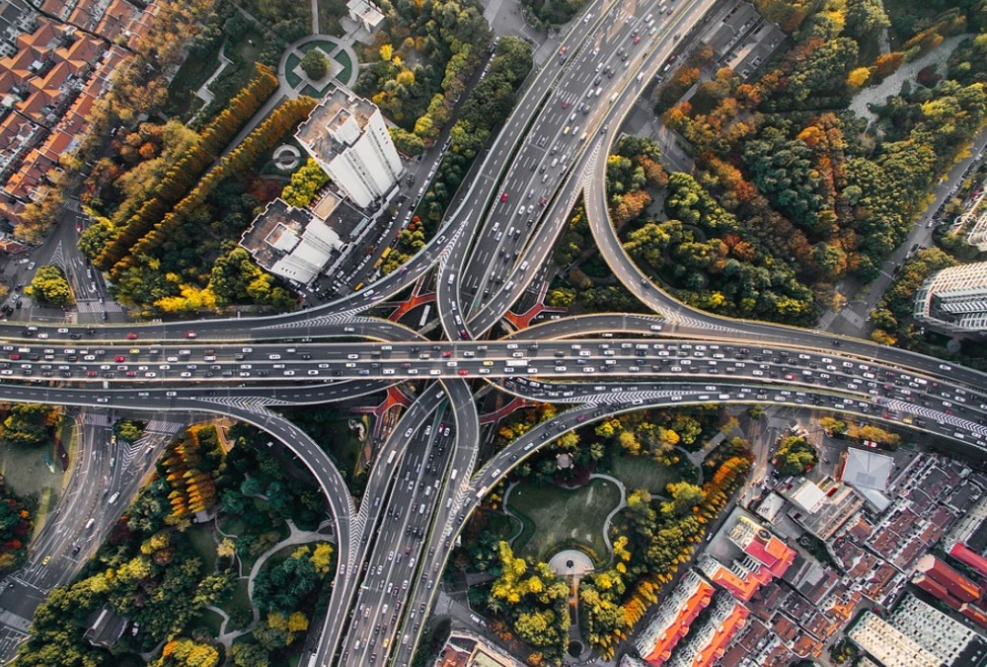
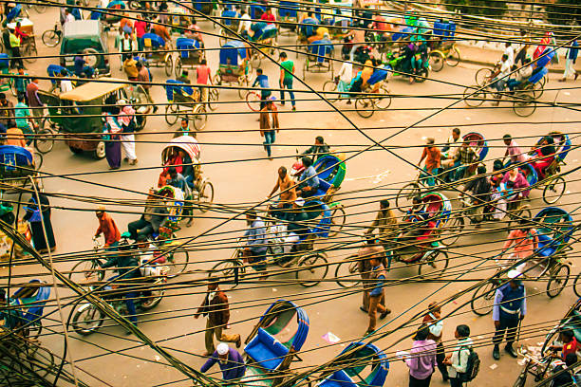
Background
Traffic in constrained environment
with clearly defined traffic rules
Traffic in unconstrained environment
without clear traffic regulations

Slide 3
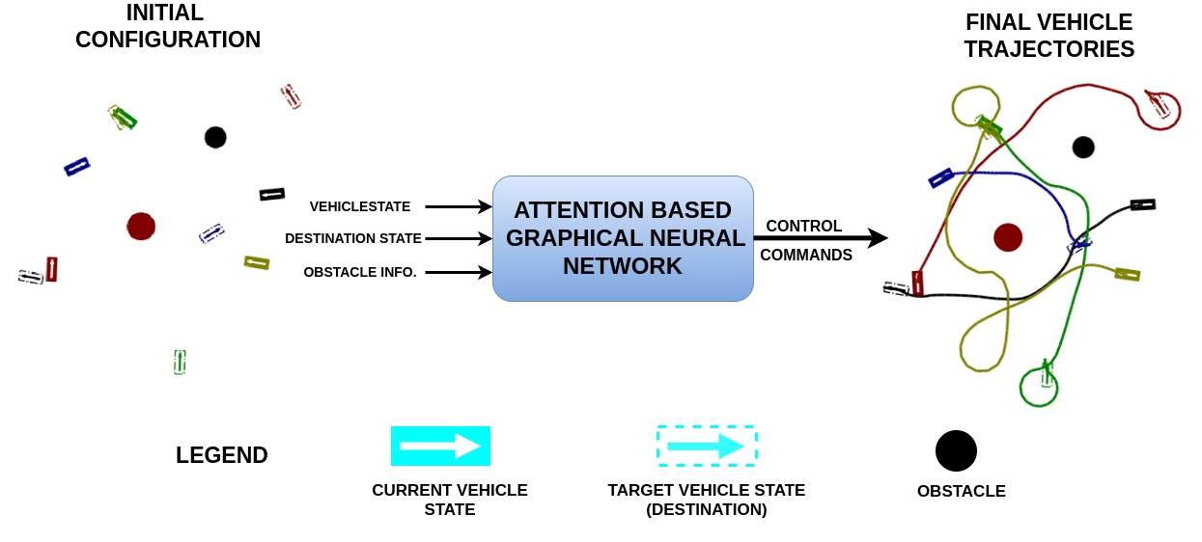
Overview
Task: Each vehicle reaches its target without collision in an unconstrained environment.

Slide 4
Overview
Task: Each vehicle reaches its target without collision in an unconstrained environment.
Possible Solutions:
Labels can be obtained by optimizing against a cost function.
But this may be too slow for real time operation.

Slide 5
Overview
Task: Each vehicle reaches its target without collision in an unconstrained environment.
Possible Solutions:
An alternate is to use a learning-based approach.

Slide 6
Overview
Task: Each vehicle reaches its target without collision in an unconstrained environment.
Dilema:
However, there are no labels for such an unconstrainted environment.
Also, human driving labels cannot be used. This is because driving is done in a constrained environment where clear traffic rules exist that need to be followed.

Slide 7
Overview
Task: Each vehicle reaches its target without collision in an unconstrained environment.
Possible Solutions:
An alternate is to use a learning-based approach.
Here, the target labels for training can be determined offline using optimization.

Slide 8
Overview
Task: Each vehicle reaches its target without collision in an unconstrained environment.
Possible Solutions:
A simple MLP is one such learning-based approach that can be trained for each agent, but a naïve MLP is unaware of its neighbouring agents.
Also, concatenating information of all agents in an MLP can only be done for a fixed number of agents.

Slide 9
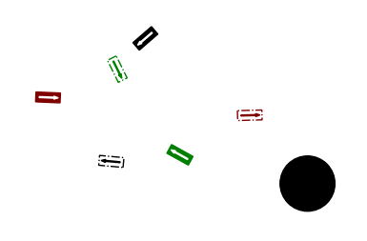
Overview
Task: Each vehicle reaches its target without collision in an unconstrained environment.
Our Solution:
We propose using a Graphical Neural Network (GNN) which can:
Attend to information from neighboring agents.
Handle a variable number of agents in the scene.

Slide 10
Overview
Task: Each vehicle reaches its target without collision in an unconstrained environment.
Our Solution:
We propose using a Graphical Neural Network (GNN) which can:
Attend to information from neighboring agents.
Handle a variable number of agents in the scene.

Slide 11
Label Generation
To determine the labels using optimization, we need to make sure:
Each vehicle reaches its target.
This is done by minimizing the distance between the vehicle's current and the target state.
Vehicles do not collide with obstacles.
This is done by adding a cost that is inversely proportional to the distance between a vehicle and an obstacle, if both are too close to each other.
Vehicles do not collide with each other.
Add a cost that is inversely proportional to the distance between any two vehicles, if they are too close to each other.

Slide 12
Model Training
An attention-based GNN is trained for prediction of control commands for each agent.
This is done by minimizing the MSE loss between the model prediction and target labels obtained from optimization.
The model is trained with at most 3 vehicles in the training dataset.
But can still perform well with 6 vehicles in the scene at inference time.

Slide 13
Model Performance
Scenario 1: 6 Vehicles, 1 Obstacle
Scenario 2: 6 Vehicles, 2 Obstacle

Slide 14
Model Performance
Scenario 3: 6 Vehicles, 3 Obstacle
Scenario 4: 6 Vehicles, 3 Obstacle

Slide 15
Comparision with other Models
Our Model:
Concatenate ego vehicle information with information from neighboring edge vehicles before calculating attention
Calculate cross attention with a U-Net inspired architecture
TransformerConv [1]:
Calculate cross attention without concatenating information from neighboring edge vehicles
Calculate cross attention with one linear layer for key and query
EdgeConv [2]:
Concatenate information from neighboring edge vehicles without use attention
GAIN [3]:
Apply self-attention on ego vehicle information and neighboring edge vehicle information
Add the ego vehicle information and neighboring edge vehicle information with a learnable weight
No Graph
[1] Shi, Yunsheng, et al. "Masked label prediction: Unified message passing model for semi-supervised classification.“
[2] Wang, Yue, et al. "Dynamic graph cnn for learning on point clouds." ACM Transactions on Graphics (tog) 38.5 (2019).
[3] Y. Liu, X. Qi, E. A. Sisbot and K. Oguchi, "Multi-Agent Trajectory Prediction with Graph Attention Isomorphism Neural Network," 2022 IEEE Intelligent Vehicles Symposium (IV)

Slide 16
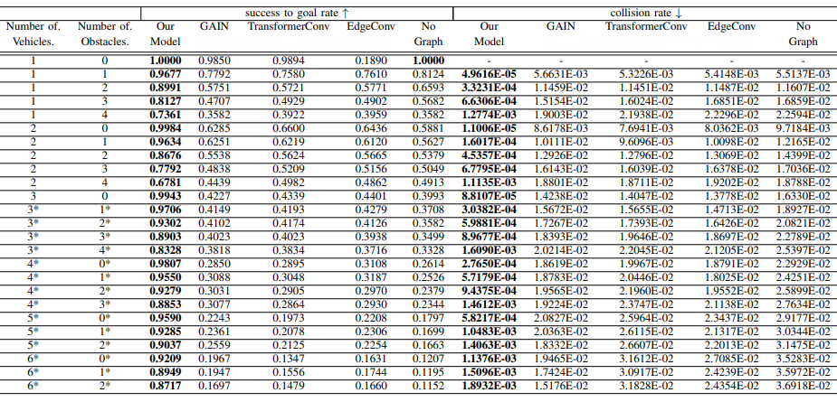
Comparision with other Models
Test data: 4000 randomly generated tasks for each case from 1 vehicle to 6 vehicles
Metrics:
Success-to-goal rate: The percentage of vehicles that successfully reach their target state without collision.
Collision rate: The total number of collisions divided by the total distance travelled by all vehicles.

Slide 17
Comparision with other Models
TransformerConv
GAINet
Our Model
EdgeConv
No Graph

Slide 18
Attention visualization

Slide 19

Thanks for the attention!
Welcome to visit our project page via link or QR code:
https://yininghase.github.io/multi-agent-control/

